Slide 1
CSE 2451 Storage-class Specifiers
Tong Liang

Slide 2
Overview
Storage duration
auto
static
thread
allocated
Redeclaration
linkage
no linkage
internal linkage
external linkage
Notes:
Source:
https://en.cppreference.com/w/c/language/storage_duration

Slide 3
Recap: multi-file program
What happens when we have a file scope variable in one of the .c source file?
Is it visible to another .c file after linking?
Source code can be divided into multiple source files
Change on one source file requires compiling of that specific file instead of all source files -> faster to update your program
source code A
source code B
source code C
Preprocessor
Preprocessor
Preprocessor
expanded code A
expanded code B
expanded code C
Translation units
compiling
Compiler
Compiler
Compiler
assembly code A
assembly code B
assembly code C
building
Assembler
Assembler
Assembler
object code A
object code B
object code C
linking
Linker
libraries
executable program

Slide 4
Storage duration
Every object has a property called storage duration, which limits the object lifetime, there are 4 kinds of storage duration in C
automatic (auto)
static
thread (_Thread_local, C11)
allocated

Slide 5
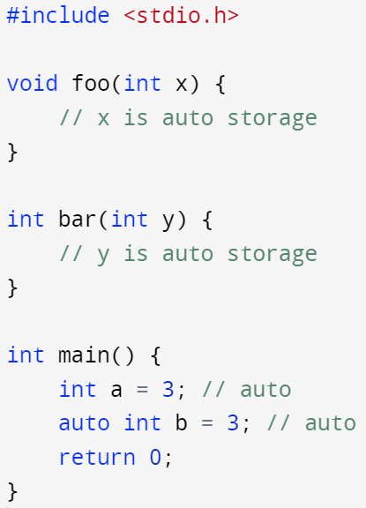
Storage duration - automatic
Automatic storage duration:
The storage is allocated when the block in which the object was declared is entered, and deallocated when it is exited by any means (goto, return, reaching the end)
If the block is entered recursively (e.g., recursive function call), a new allocation is performed for every recursion level
All function parameters and non-static block-scope objects have this storage duration

Slide 6
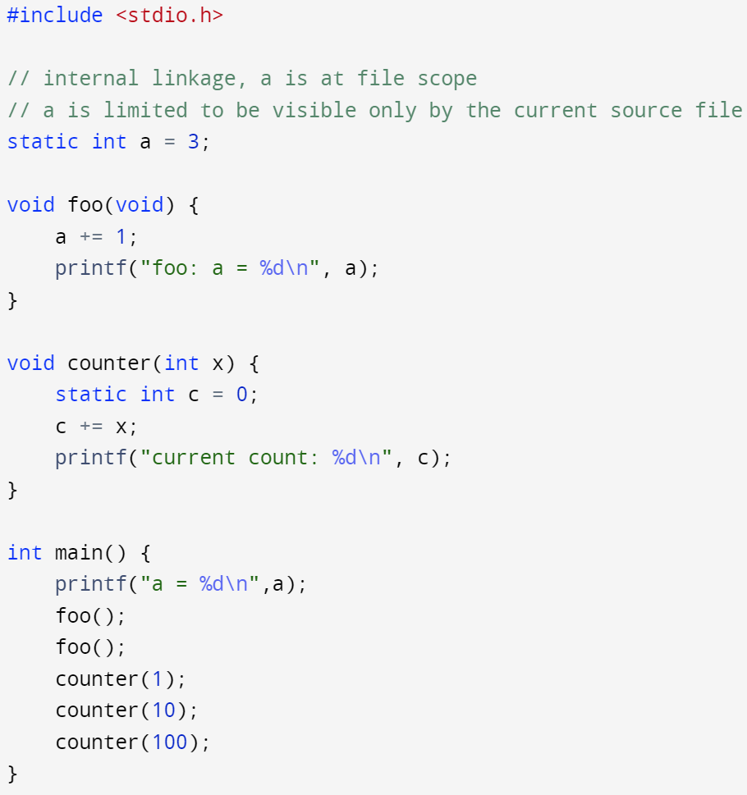
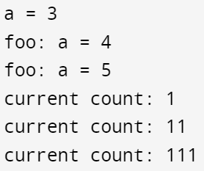
Storage duration - static
Static storage duration:
the storage duration is the entire execution of the program
the value stored in the object is initialized only once, prior to the main function
All objects declared static and all objects with either internal or external linkage that aren’t declared _Thread_local have this storage duration
Static variable’s default value is 0 if no initialization value is given at the time of declaration

Slide 7
Storage duration – thread and allocated
Thread storage duration:
The storage duration is the entire execution of the thread in which it was created
the value stored in the object is initialized when the thread is started
Each thread has its own, distinct, object
Allocated storage duration: the storage is allocated and deallocated on request, using dynamic memory allocation functions
malloc()
calloc()
realloc()
free()

Slide 8
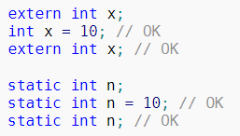


Redeclaration – rules simplify usage of header files
A declaration cannot introduce an identifier if another declaration for the same identifier in the same scope appears earlier, except that
Declarations of the objects with linkage (external or internal) can be repeated
typedef can be repeated as long as it names the same type
Struct and union declarations can be repeated
A type may have multiple aliases, an alias can only be defined for one type
We’ve seen this when introducing struct, declare first, then define with actual member list

Slide 9
Linkage
Linkage refers to the ability of an identifier (variable or function) to be referred to in other scopes. There are 3 kinds of linkages
No linkage
Internal linkage
External linkage

Slide 10
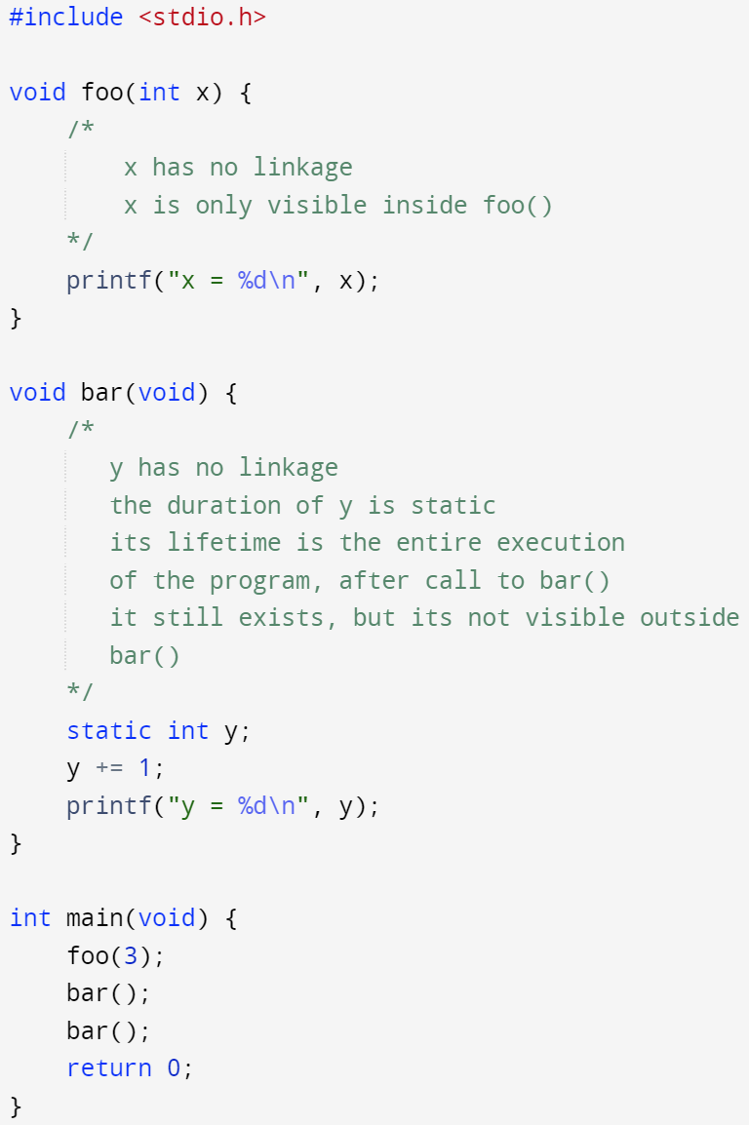

Linkage – no linkage
No linkage:
The identifier can be referred to only from the scope it is in.
All function parameters and all non-extern block-scope variables (including the ones declared as static) have this linkage

Slide 11
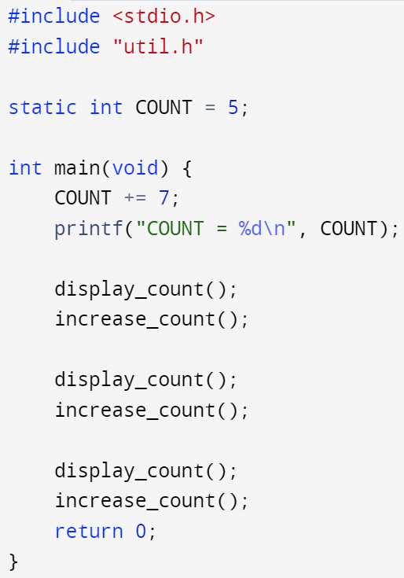
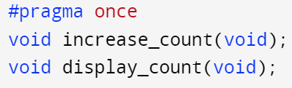
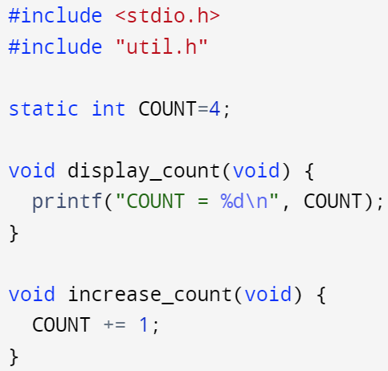
Linkage – internal linkage
Internal linkage:
the identifier can be referred to from all scopes in the current translation unit (visibility is limited to the current translation unit only even if it’s a part of a bigger multi-file program)
All static file scope identifiers (both functions and variables) have this linkage
main.c
util.h
12
util.c
4
5
6

Slide 12
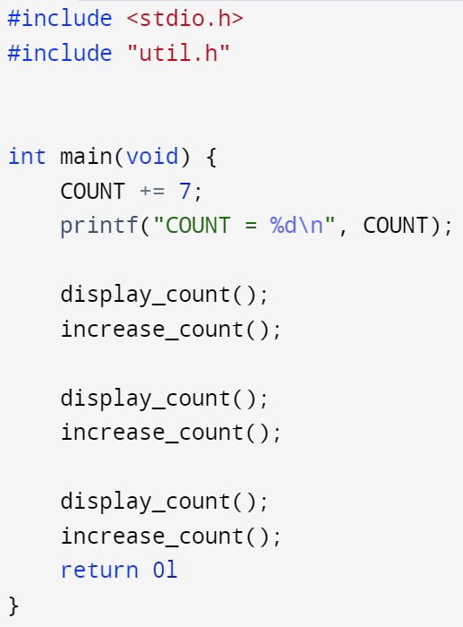
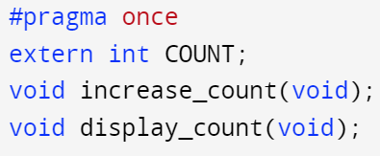
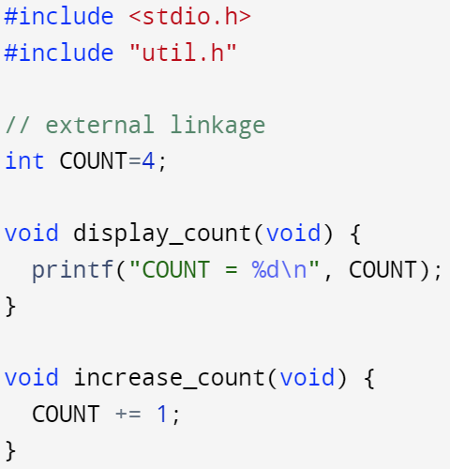
Linkage – external linkage
External linkage:
The identifier can be referred to from any other translation units in the entire program
All non-static functions, all extern variables (unless earlier declared static, i.e., redeclaration), and all file-scope non-static variables have this linkage
File scope identifiers, unless explicitly declared with static, are extern by default
main.c
util.h
11
util.c
11
12
13

Slide 13
Storage-class specifiers
Storage-class specifiers appear in declarations. At most one specifier may be used (except _Thread_local may be combined with static or extern to adjust linkage since C11)
The storage-class specifiers determine two independent properties of the names they declare: storage duration and linkage:
Storage-class specifiers | Storage duration | linkage | Properties & limits
auto | automatic storage duration | no linkage | Only allowed for objects at block scope, function scope (excluding function param list)
register | automatic storage duration | no linkage | Only allowed for objects at block scope, function scope (including function param list). It suggests the optimizer to store the value of this variable in a CPU register if possible. Regardless of this optimization take place or not, variables declared register cannot be used as operand to the address-of operator (&), and register array are not convertible to pointers
static | static storage duration | internal linkage | It can be used with functions at file scope and objects at both file and block scope
extern | static storage duration | external linkage | It can be used with functions and objects declarations in both file and block scope (excluding function parameter lists)
_Thread_local (C11) | thread storage duration | internal / external linkage | It can not be used with function declarations. If it is used on a declaration of an object, it must be present on every declaration of the same object. If its used on a block-scope declaration, it must be combined with either static or extern to decide linkage

Slide 14
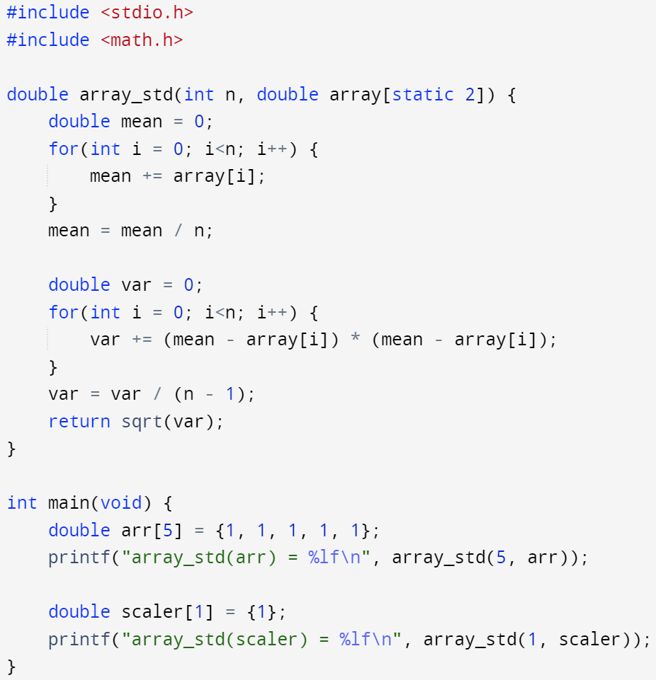
Storage-class specifiers
This tells the compiler that it should assume the array passed to array_std() has at least 2 elements -> otherwise, issue warning messages during compilation
Note: the warning message is not a feature required by the standard for all compilers, in this case, gcc doesn’t make any complaints, but clang does
If no storage-class specifier is provided, the defaults are:
extern for all functions -> functions have external linkage by default
extern for objects at file scope
auto for objects at block scope
For any struct or union declared with a storage-class specifier, the storage duration (but not linkage) applies to their members recursively
Function declarations at block scope can use extern or none at all. Functions declarations at file scope can use extern or static
Function parameters cannot use any storage-class specifiers other than register. Note that static has special meaning in function parameters of array type

